Slide 1
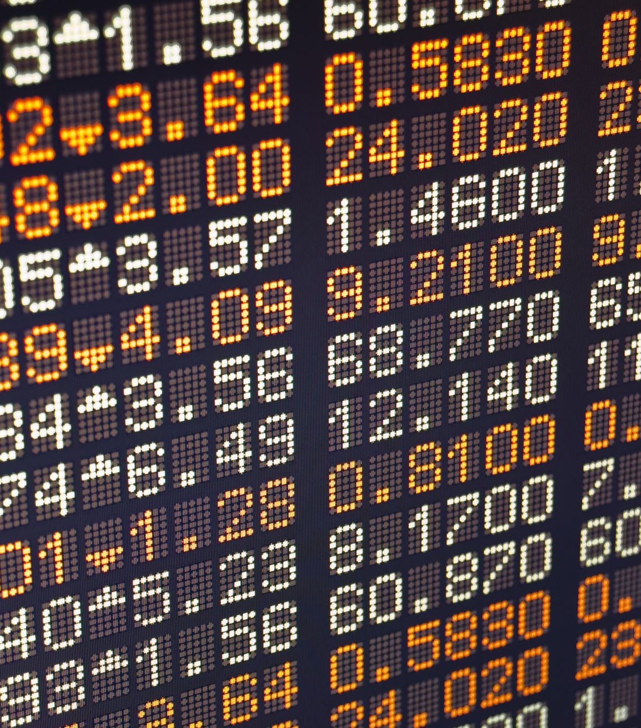
Stock Market Prediction System
Presented By:
Vrutika Shah
Vedant Khawase
Preyanshi Parmar

Slide 2
Objective
To develop a web application for stock price prediction.
To examine different forecasting techniques to predict future stock returns based on past returns and news indicators to construct a portfolio of multiple stocks to diversify the risk.
To provide stock price prediction using time series algorithms based on historical data to give accurate predictions.
Provide data to aid financial analysts and investors in making wise investment choices.

Slide 3
Traditional Stock Prediction Website
Historical Data And Financial Statements
Limited speed as it is done by human
Take time to adapt change in data source
Accuracy needs expert knowledge

Slide 4
Solution with AI Stock Prediction
Historical Data Analysis
Efficient and quick analysis of large of amount of data to high-frequency trading
Quickly adapt the change in data source to stay up to date with market and provide relevant data
Highest accuracy due to a trained model with vast and diverse data

Slide 5
Dataset
We’ll be using data from Yahoo Finance & we took 10 years data from present date for the below stocks.
AMZN : Amazon
WMT : Walmart
AAPL : Apple
MSFT : Microsoft

Slide 6
Data Flow
Collect Data
Preprocessing (Scaling Data)
Evaluate performance
Train Model
Explore & Analyze data
Analyze Data
Split dataset
Predict

Slide 7
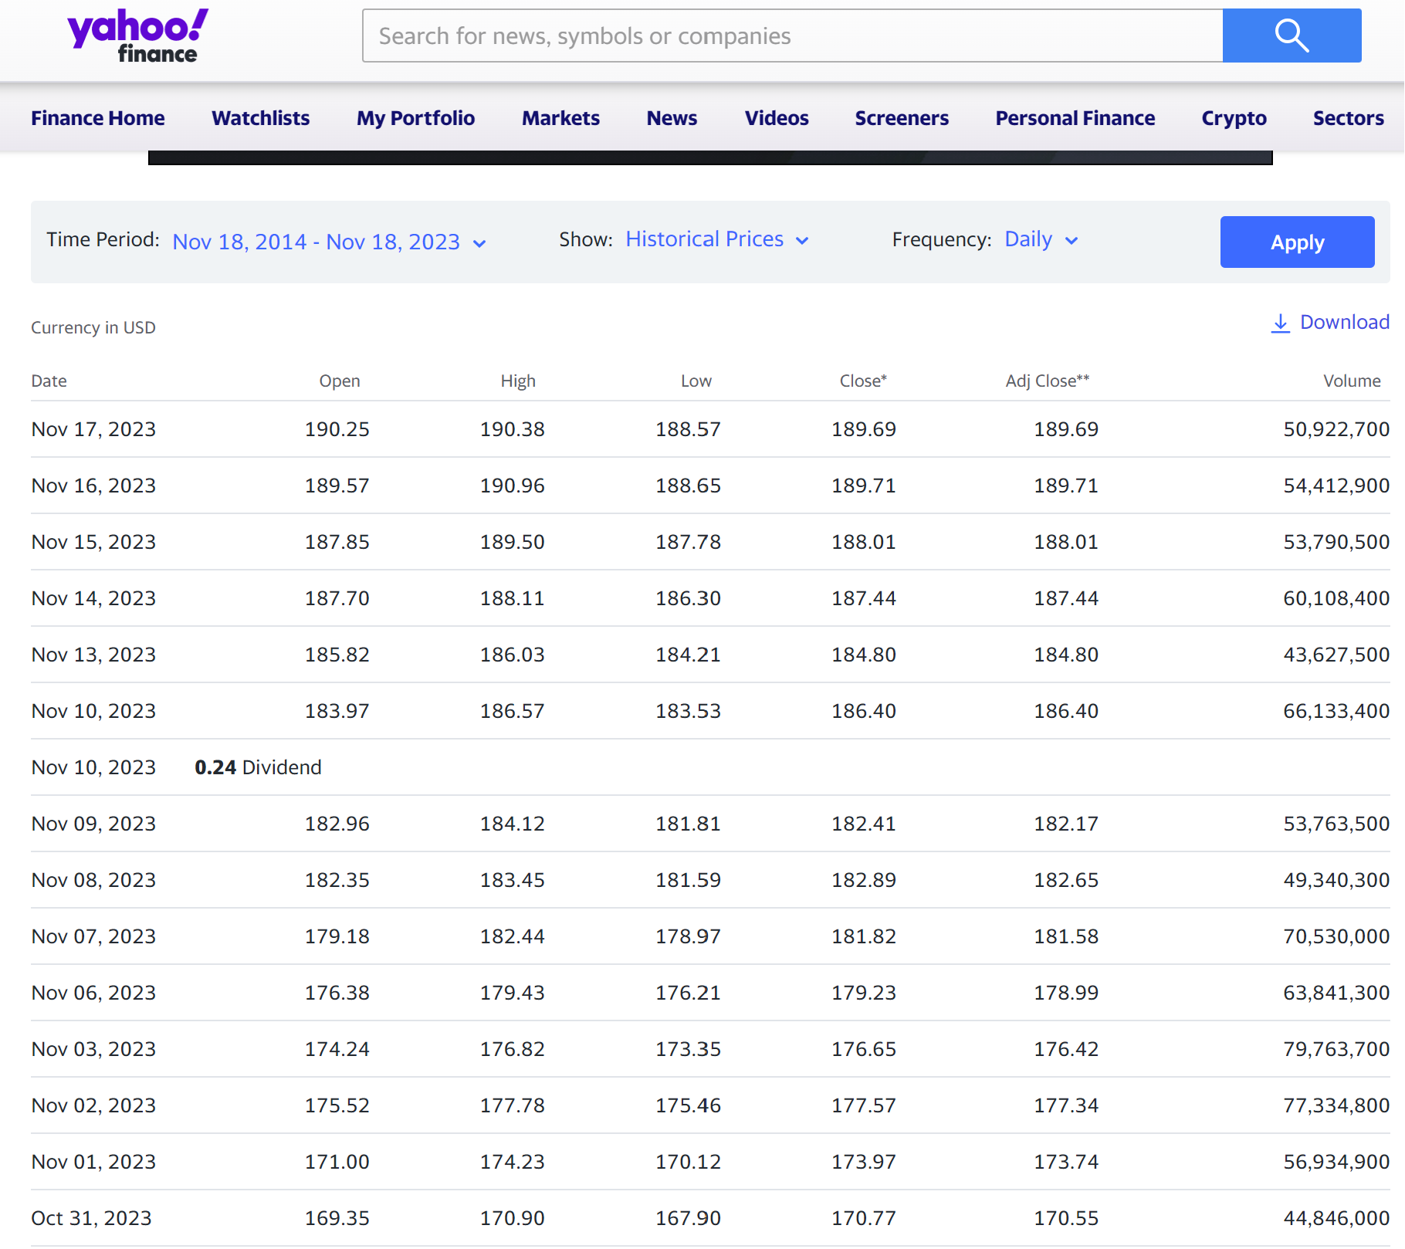
Data Collection
Downloaded the data from Yahoo Finance.

Slide 8
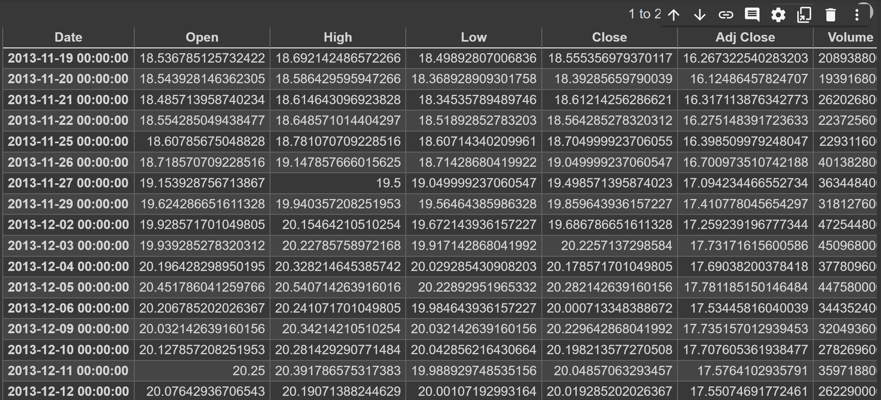
Data Exploration

Slide 9
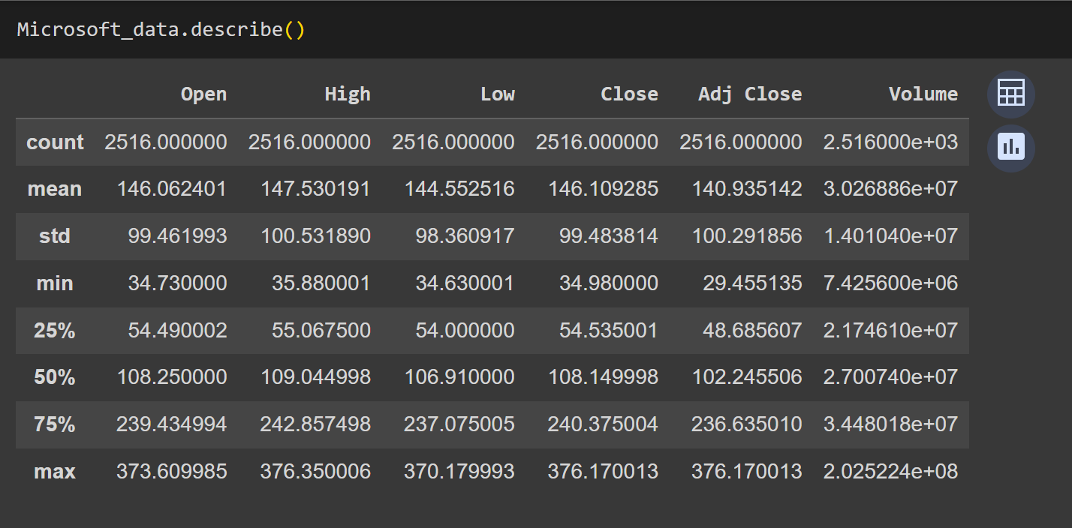
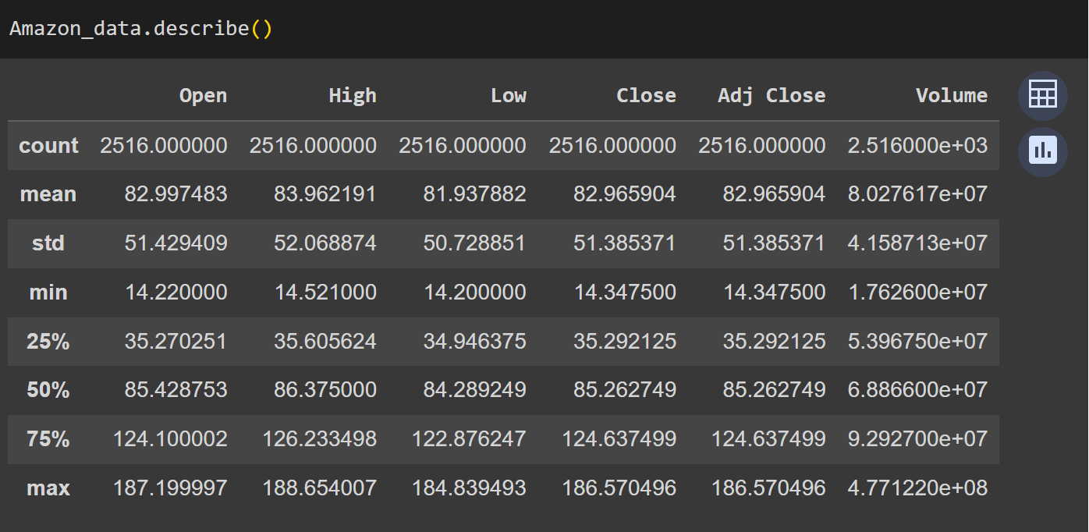
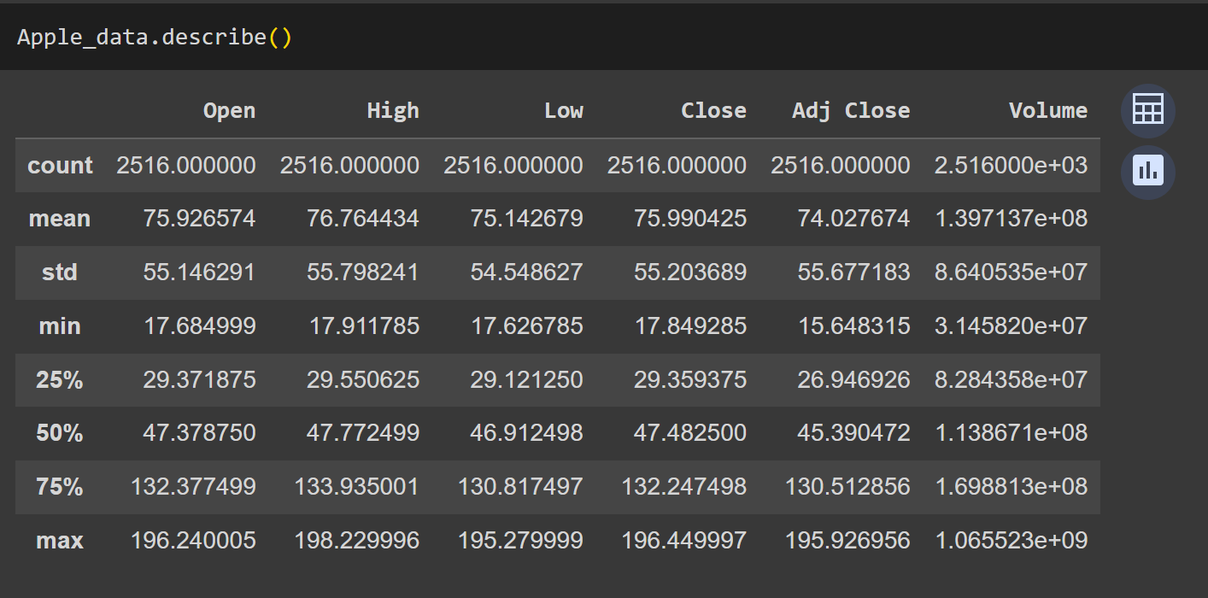
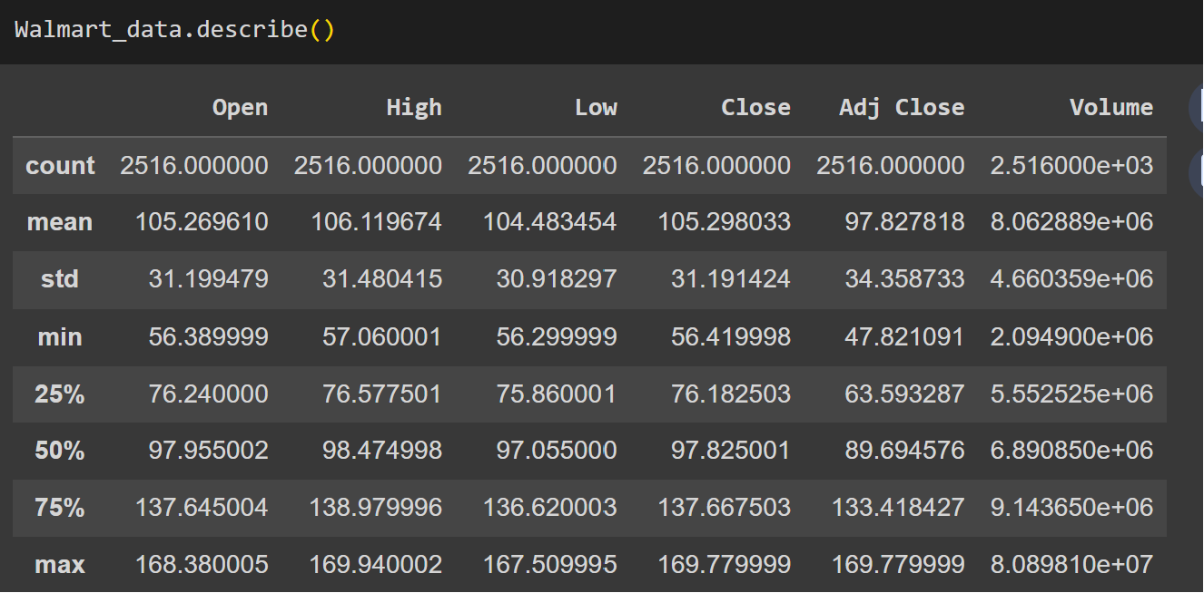
Data Exploration

Slide 10
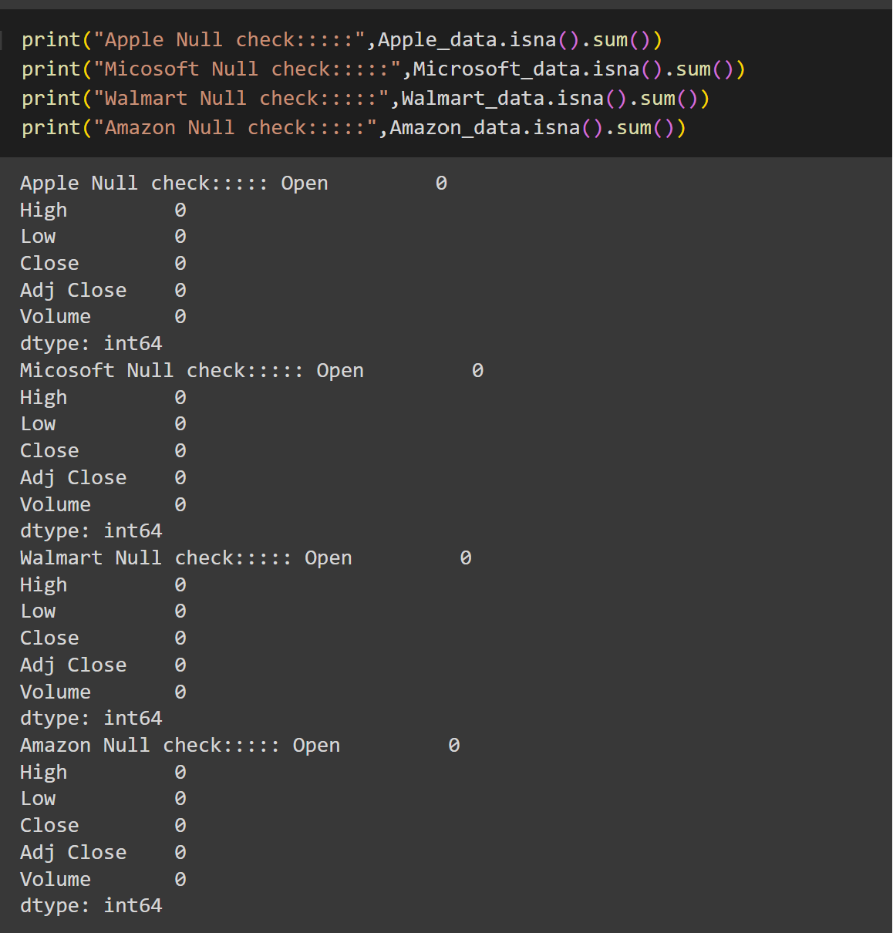
Data Exploration

Slide 11
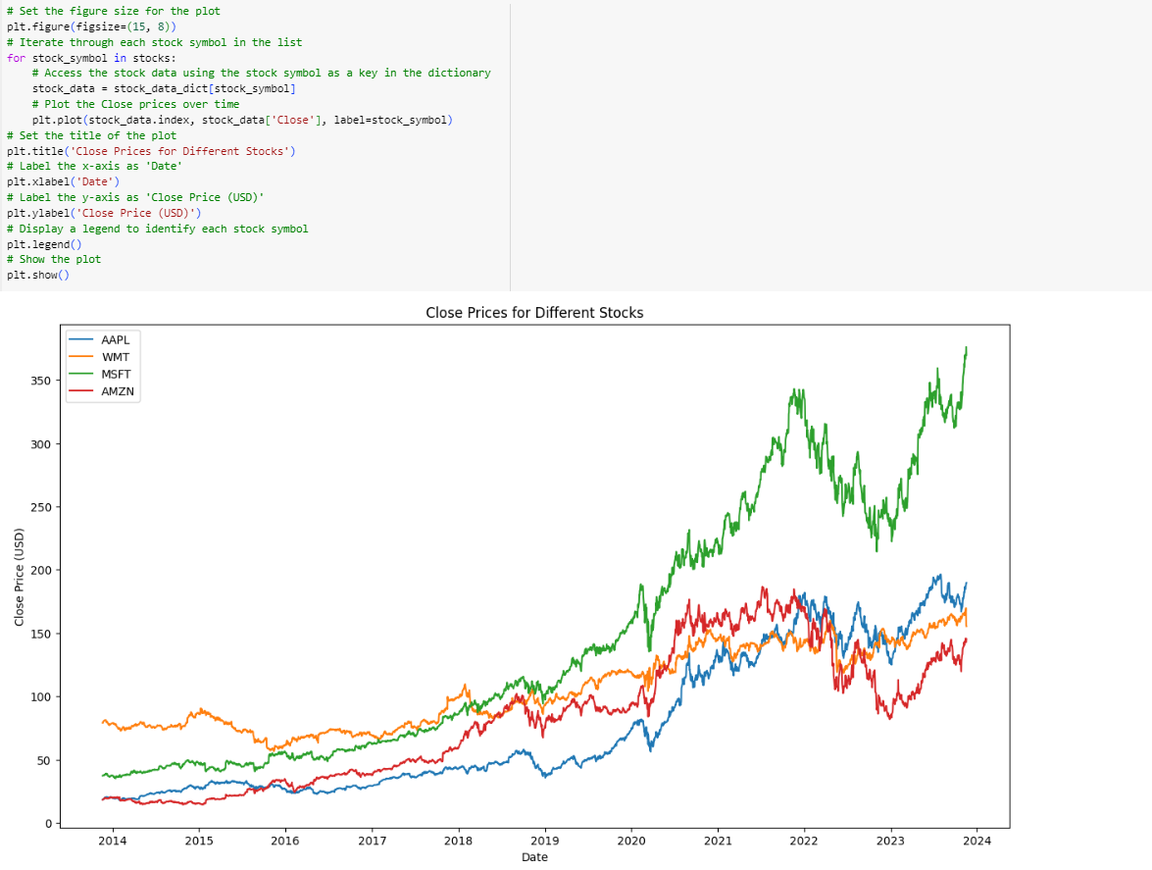
Data Exploration

Slide 12
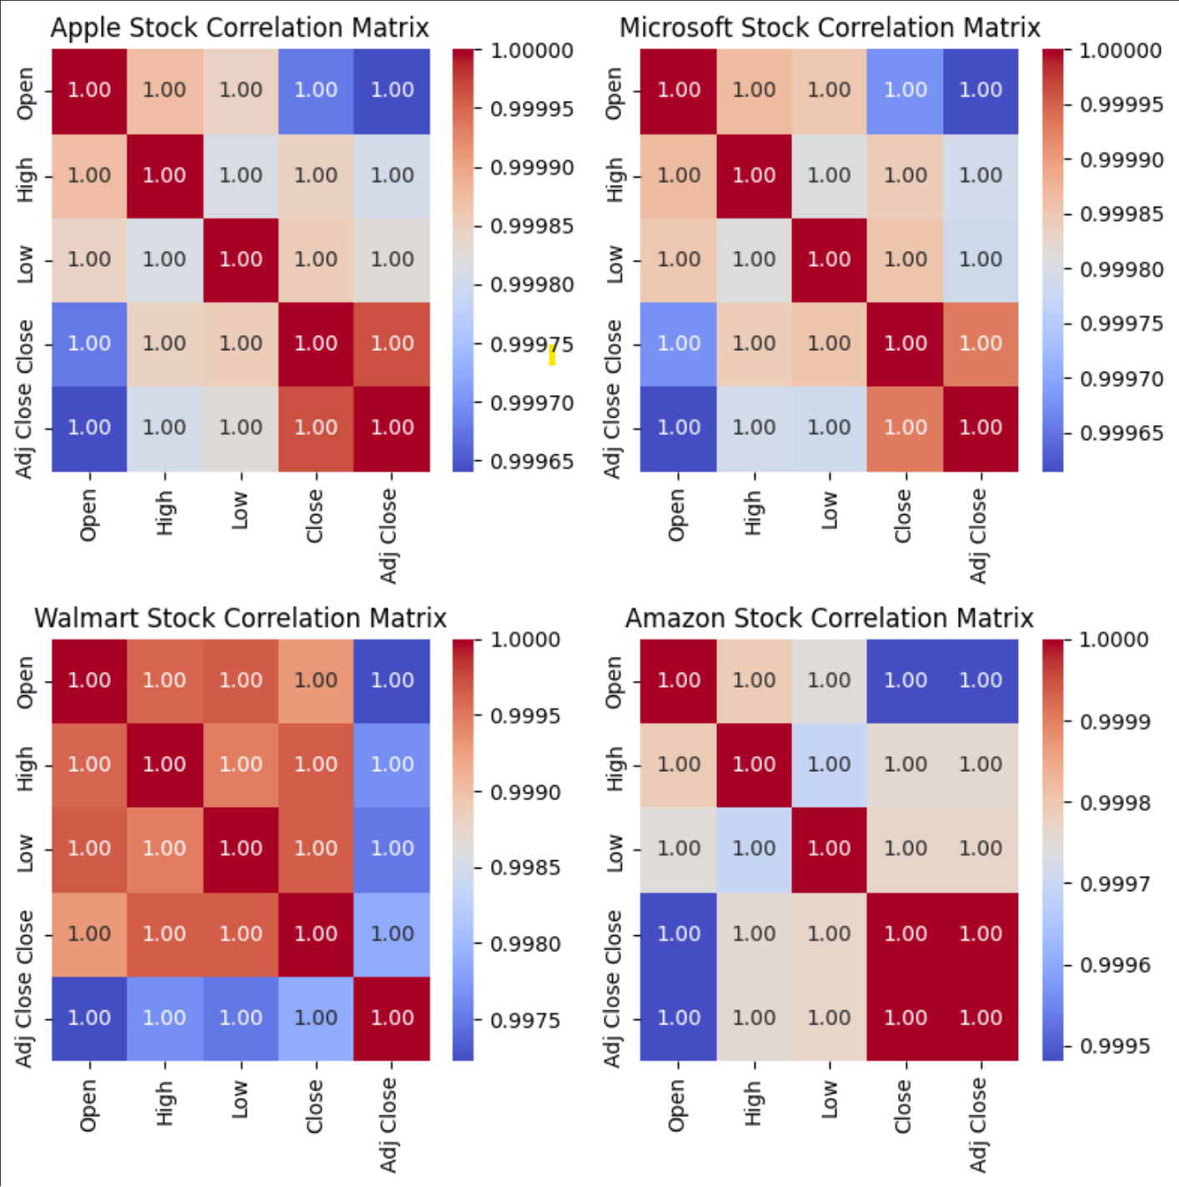
Correlation Matrix

Slide 13
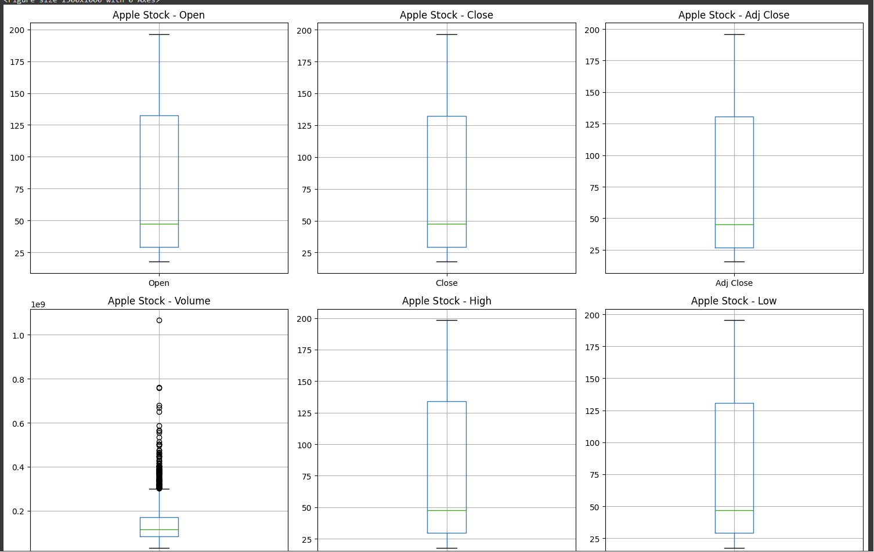
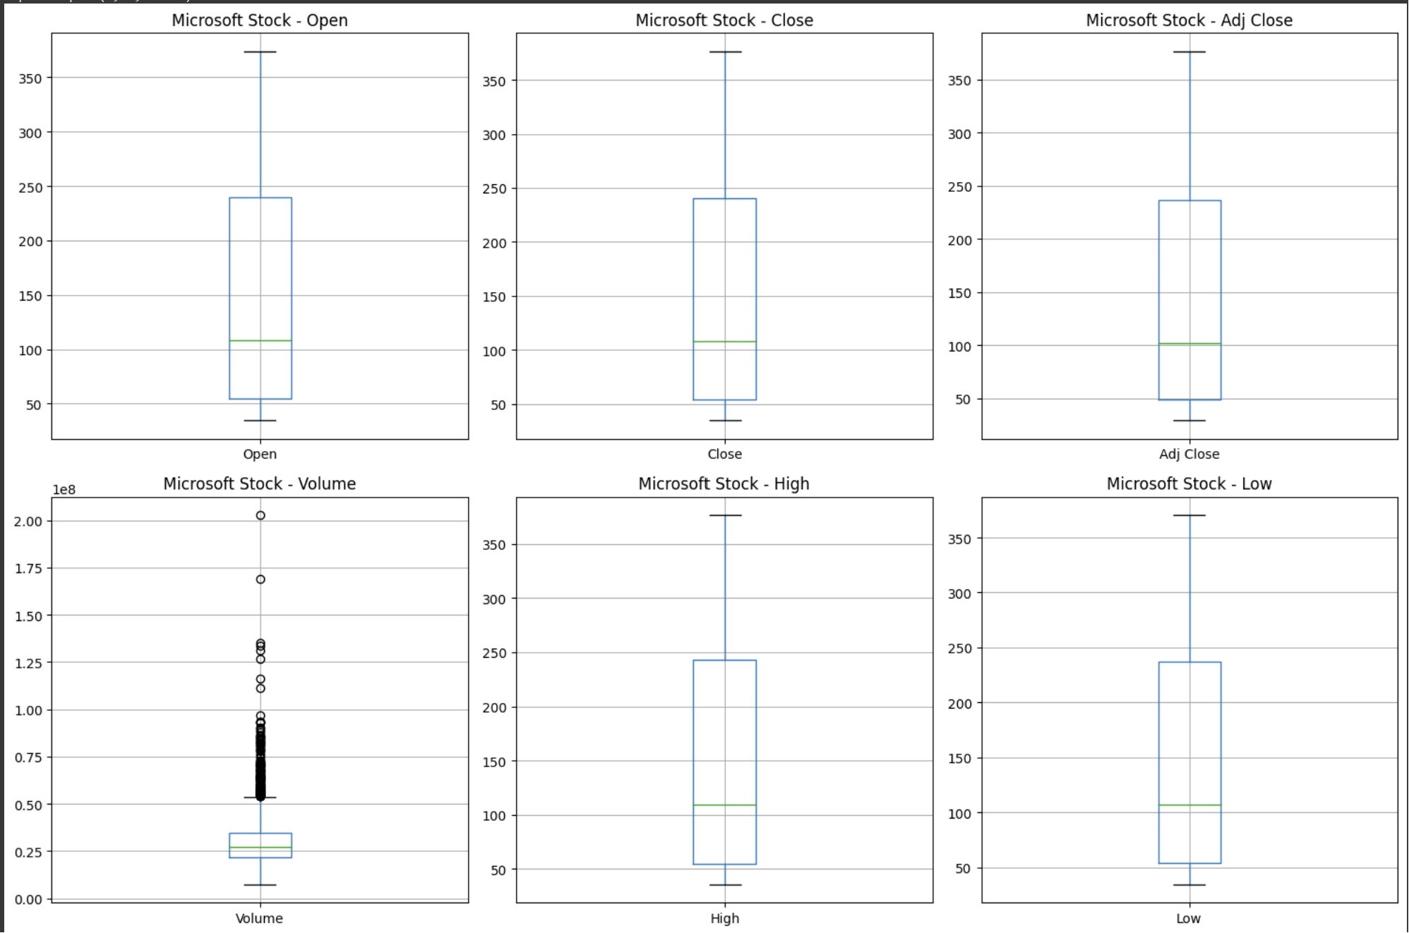
Outliers-1
Microsoft
Apple

Slide 14
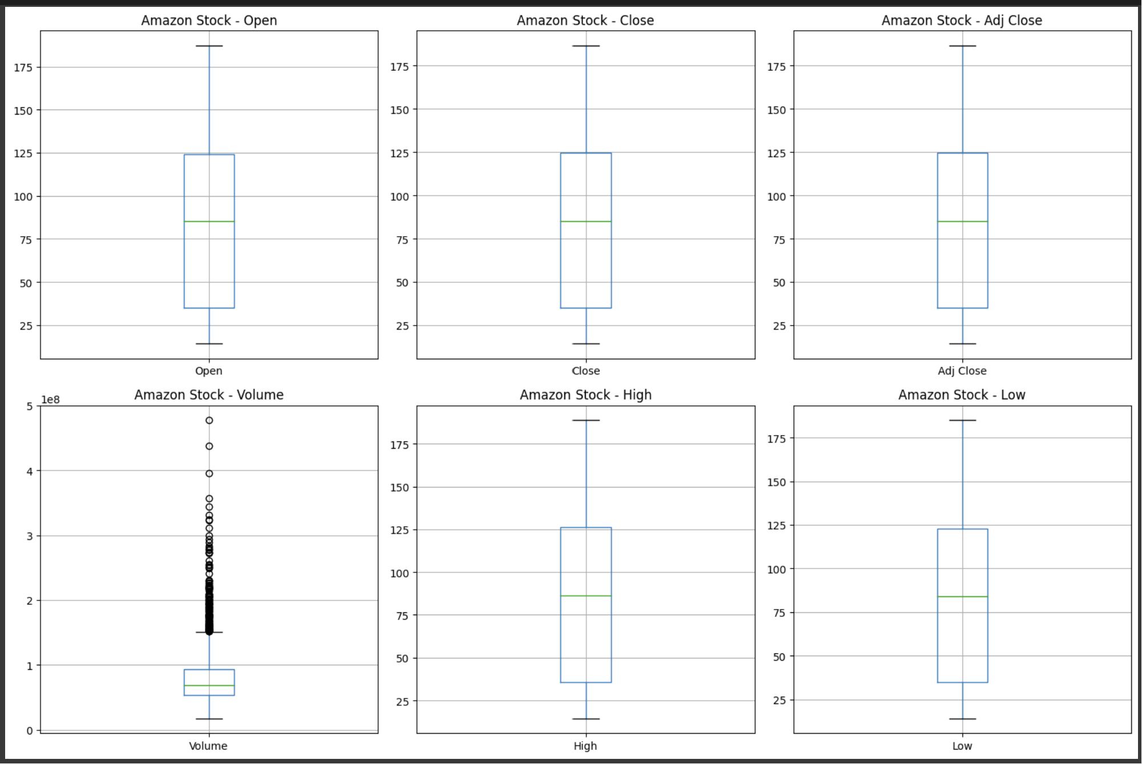
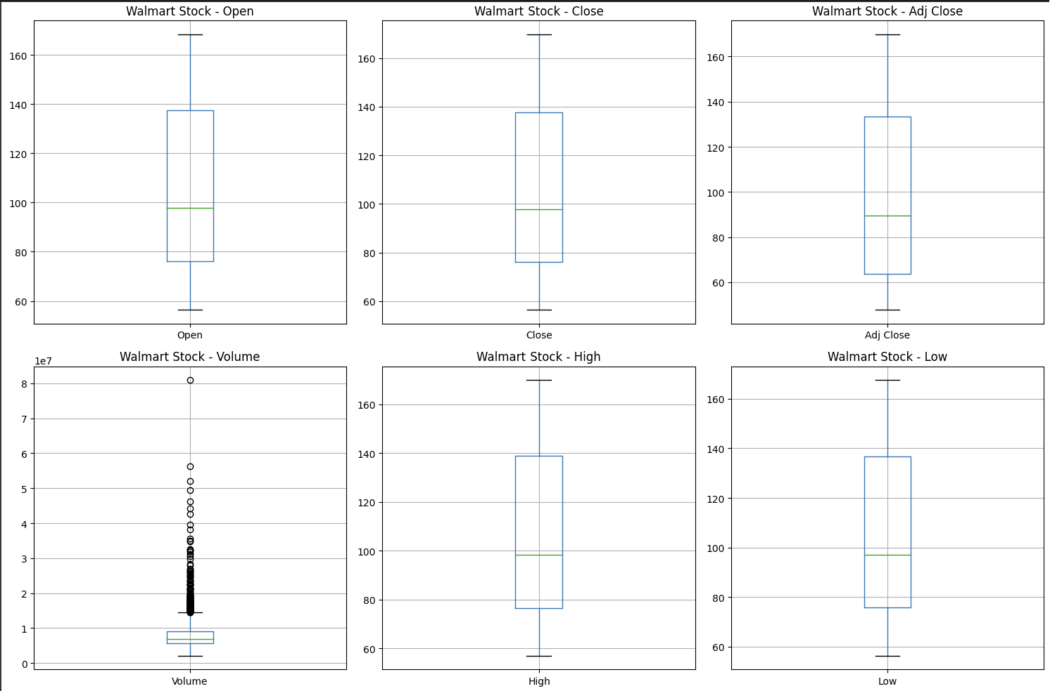
Outliers-2
Walmart
Amazon

Slide 15
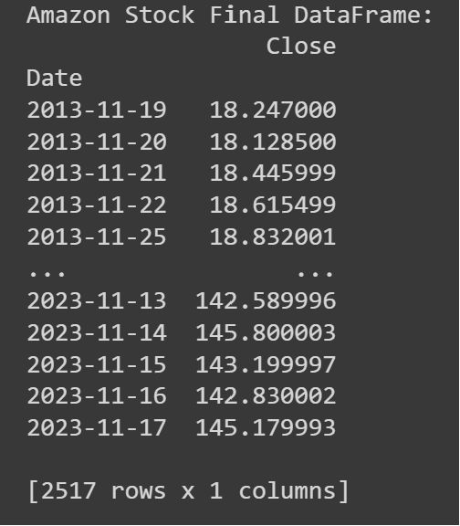
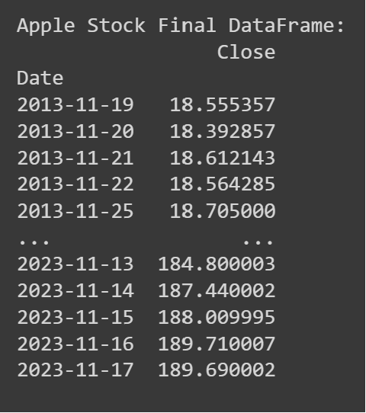
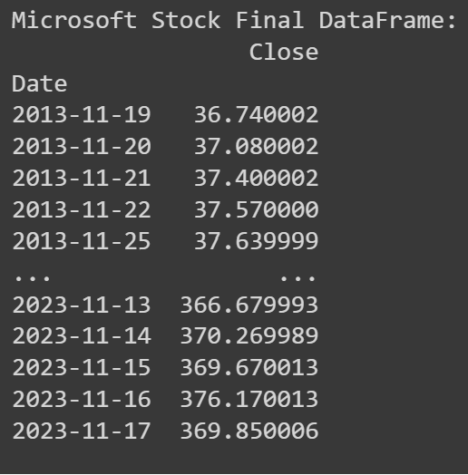
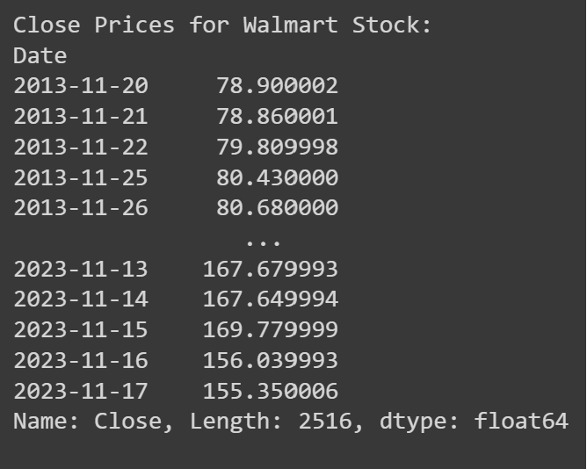
Preprocessing Data
Amazon
Apple
Microsoft
Walmart

Slide 16
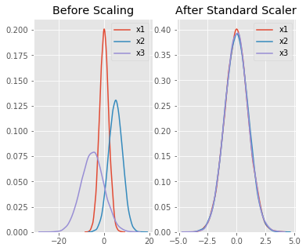
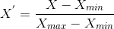
Normalization
Scale the values in a dataset to a common range.
To make data processing and modelling easier
We have used MinMaxScaler to make data between the range of 0 to 1.
The formula:
When the X value is minimum : 0 value
When the X value is maximum : 1 value
When the X value is between min or max : value between 0 to 1.
X(min) – minimum value, X(max) – maximum value
16

Slide 17
Analysis Methodologies of Stock markets
We will be utilizing supervised learning with a combination of the following methods and technologies:
Simple RNN

Slide 18
Simple Recurrent Neural Networks (RNNs)
Data is sequential, with each data point dependent on previous ones.
Model captures information from previous time steps, making them capable of maintaining memory and capturing long-term dependencies.
Model trained on historical stock data to learn patterns and trends
Helps to make predictions based on similar patterns in new data.
It works on sequence of past value and based on that predict the future

Slide 19
Reshape Data for Simple RNN
In Stock Prediction we are predicting the Future close price of the Stock.
Not possible to predict based on only yesterday’s price
Need to understand patterns and trends of the past months and years.
Here, we will consider last 30 days close price to predict today’s price.
Simple RNN, works as below:
X (Feature matrix) | Target (y)
Close[0:30] | Close[30]
Close[1:31] | Close[31]
Close[2:32] | Close[32]
Close[3:33] | Close[33]
Close[4:34] | Close[34]

Slide 20
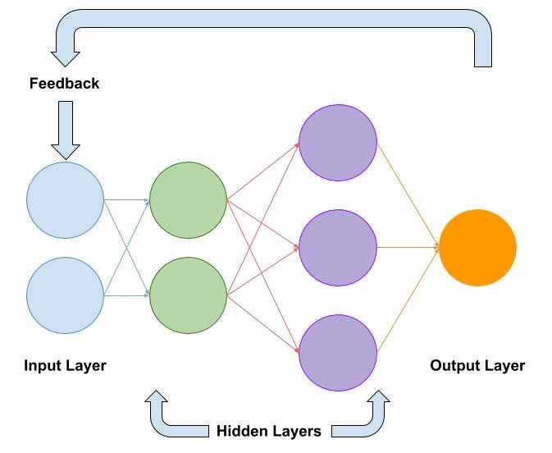
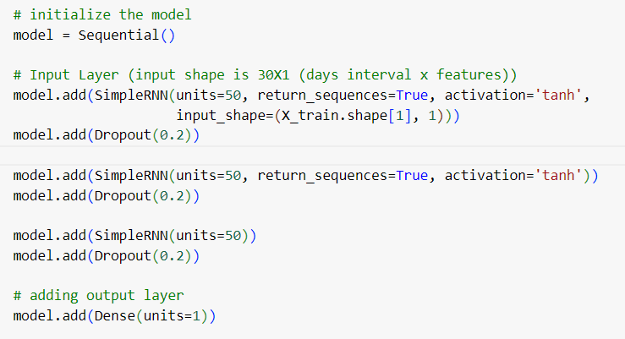
Simple RNN Architecture

Slide 21
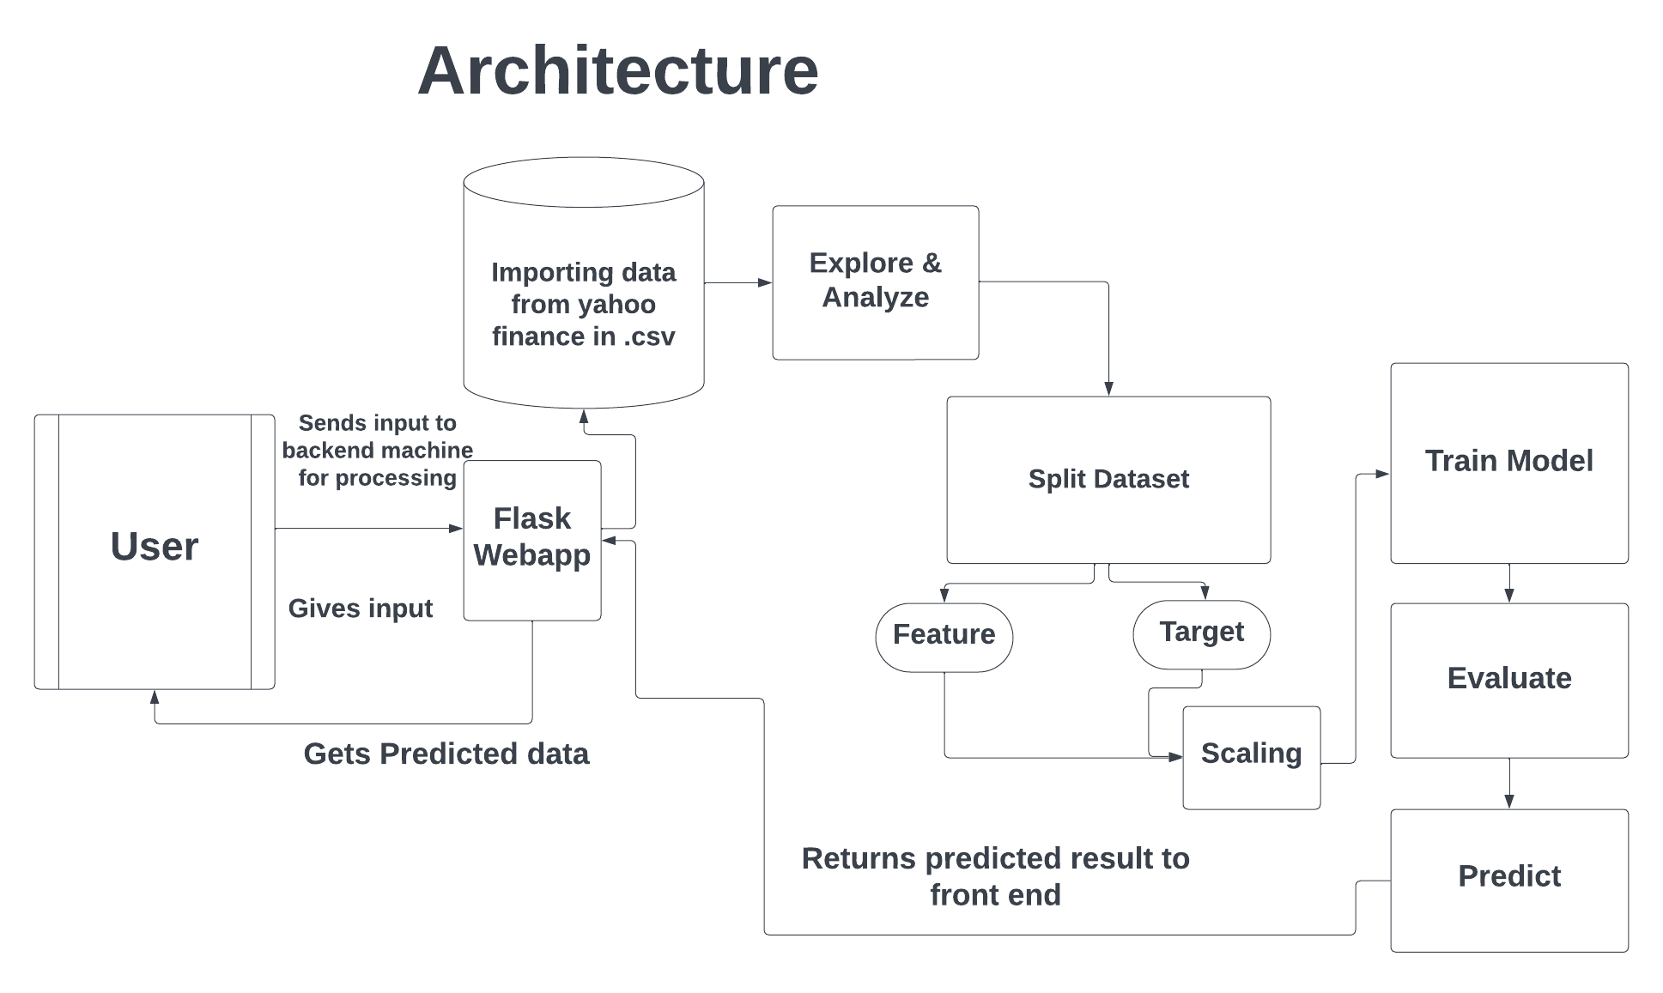
Architecture

Slide 22
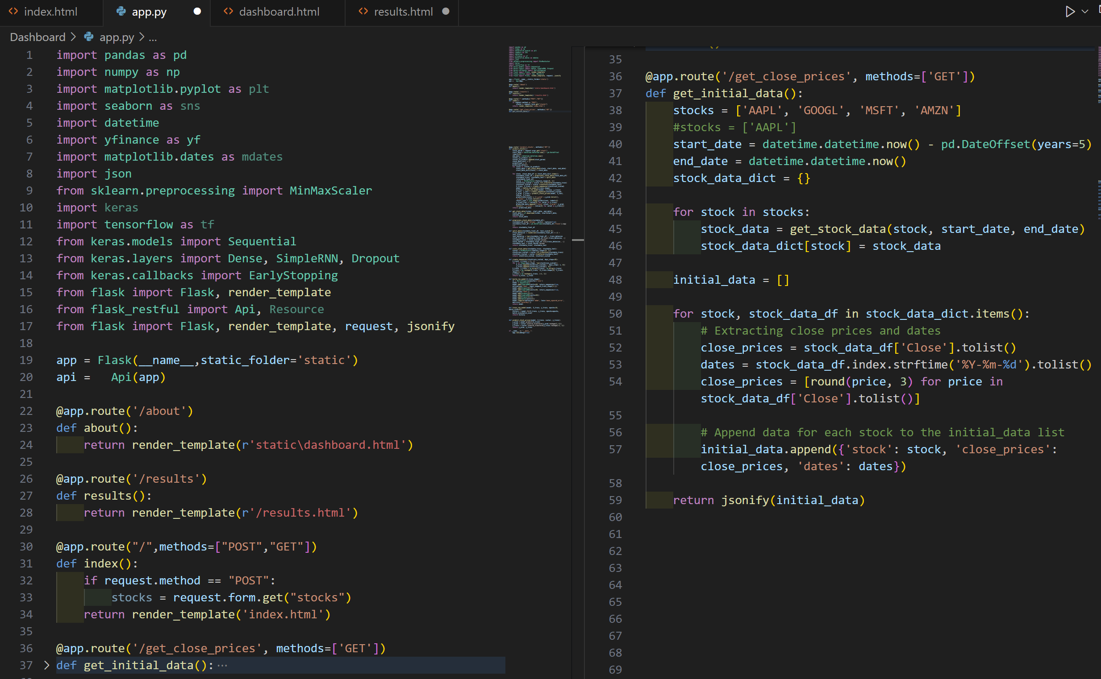
Code Representation- Purpose of each section- The Flask application (app.py) fetches and processes historical stock data for selected stocks, rendering web pages for About and results.

Slide 23
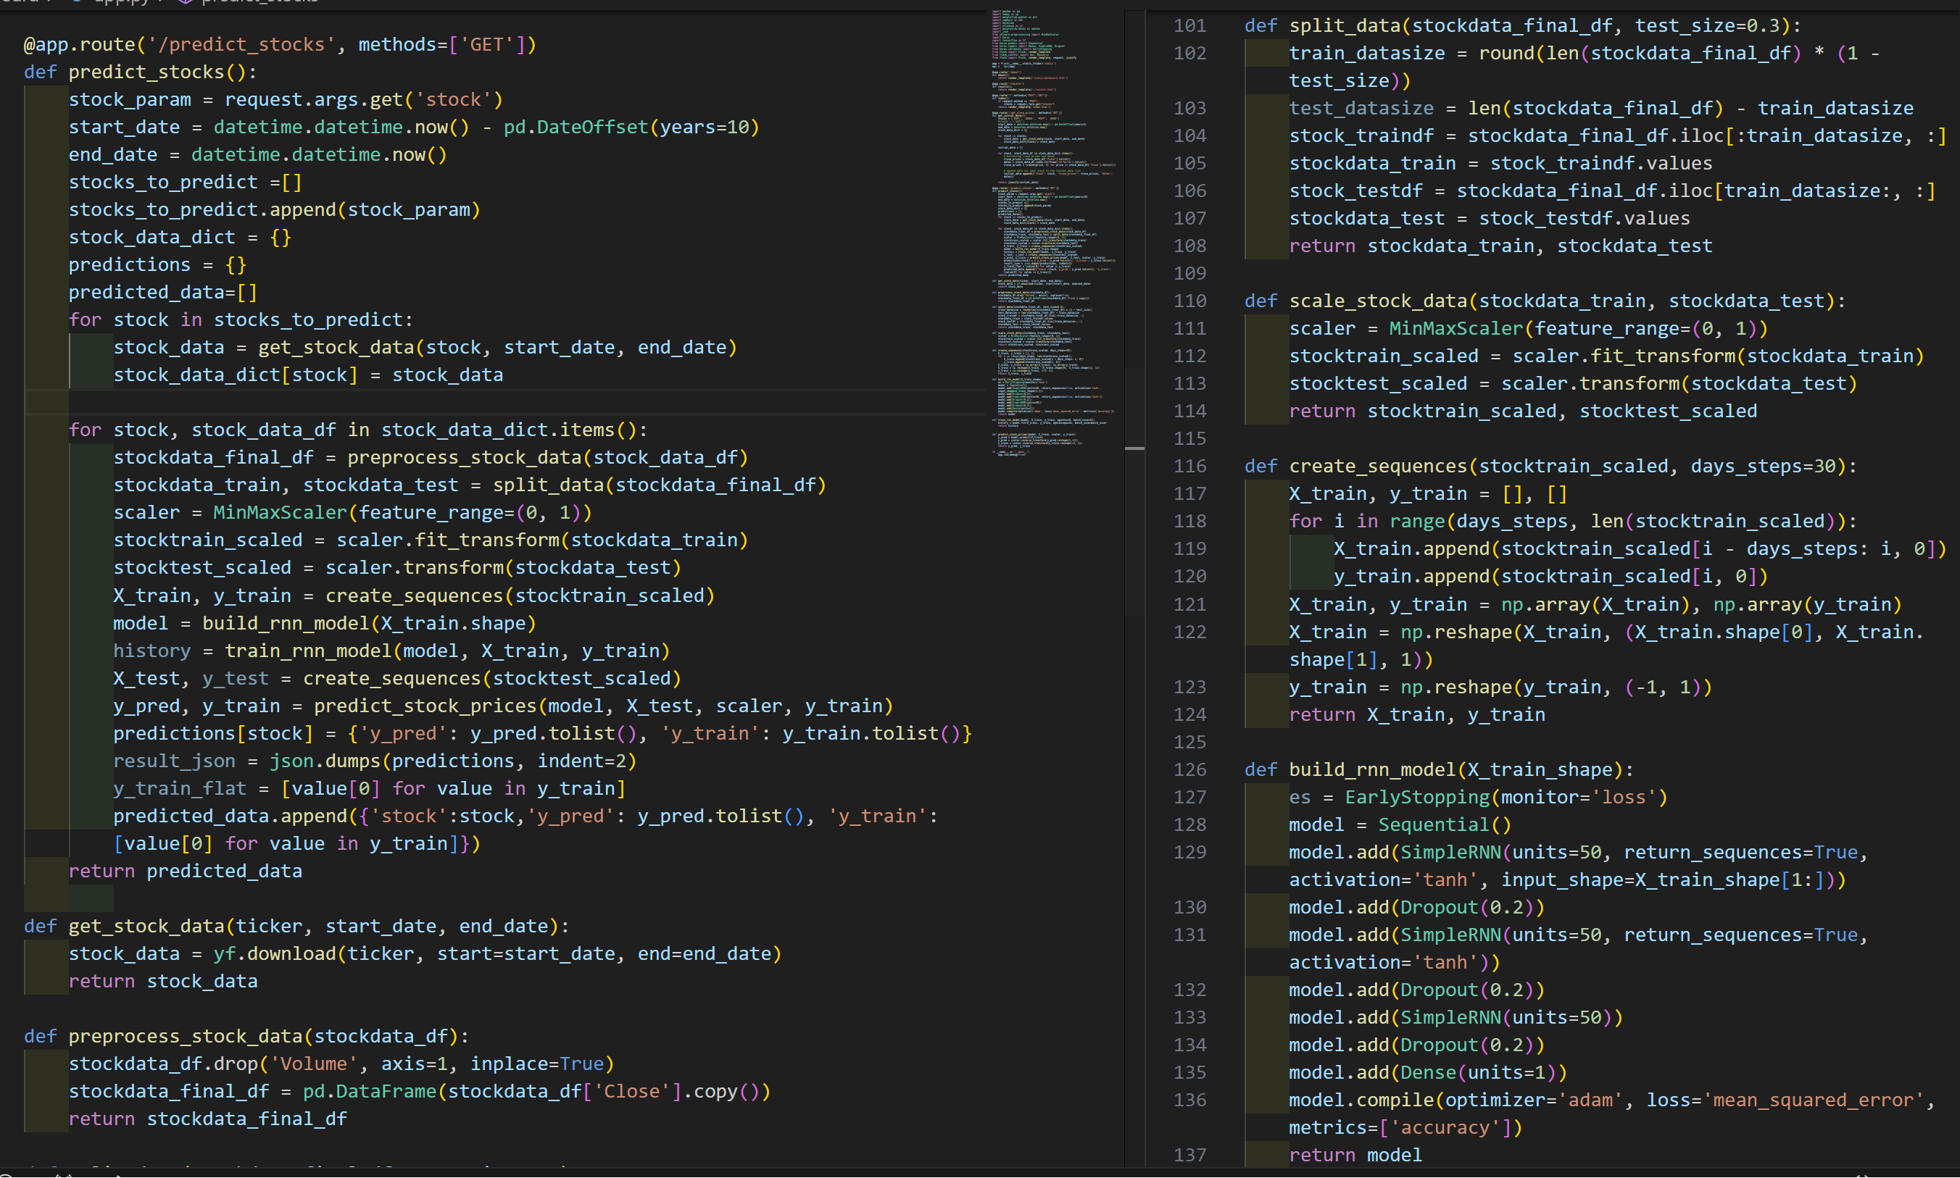
Stock Data Processing ,Model Building and Prediction- This code segment encompasses the essential functions for data processing, sequence creation, and RNN modeling in a Flask application.

Slide 24
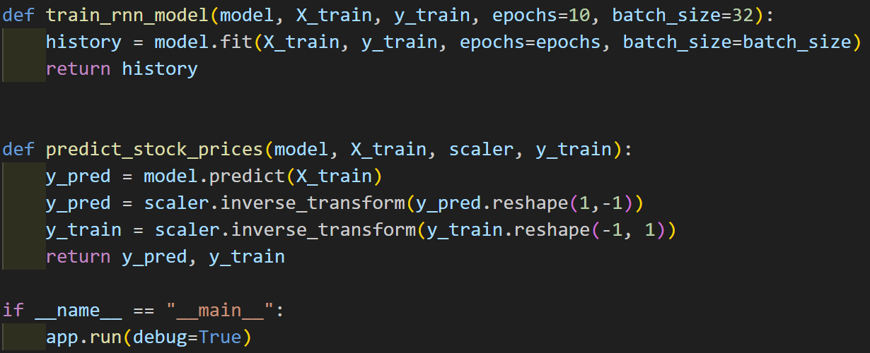
RNN Model Training code- This code trains an RNN model and predicts stock prices using Keras.

Slide 25
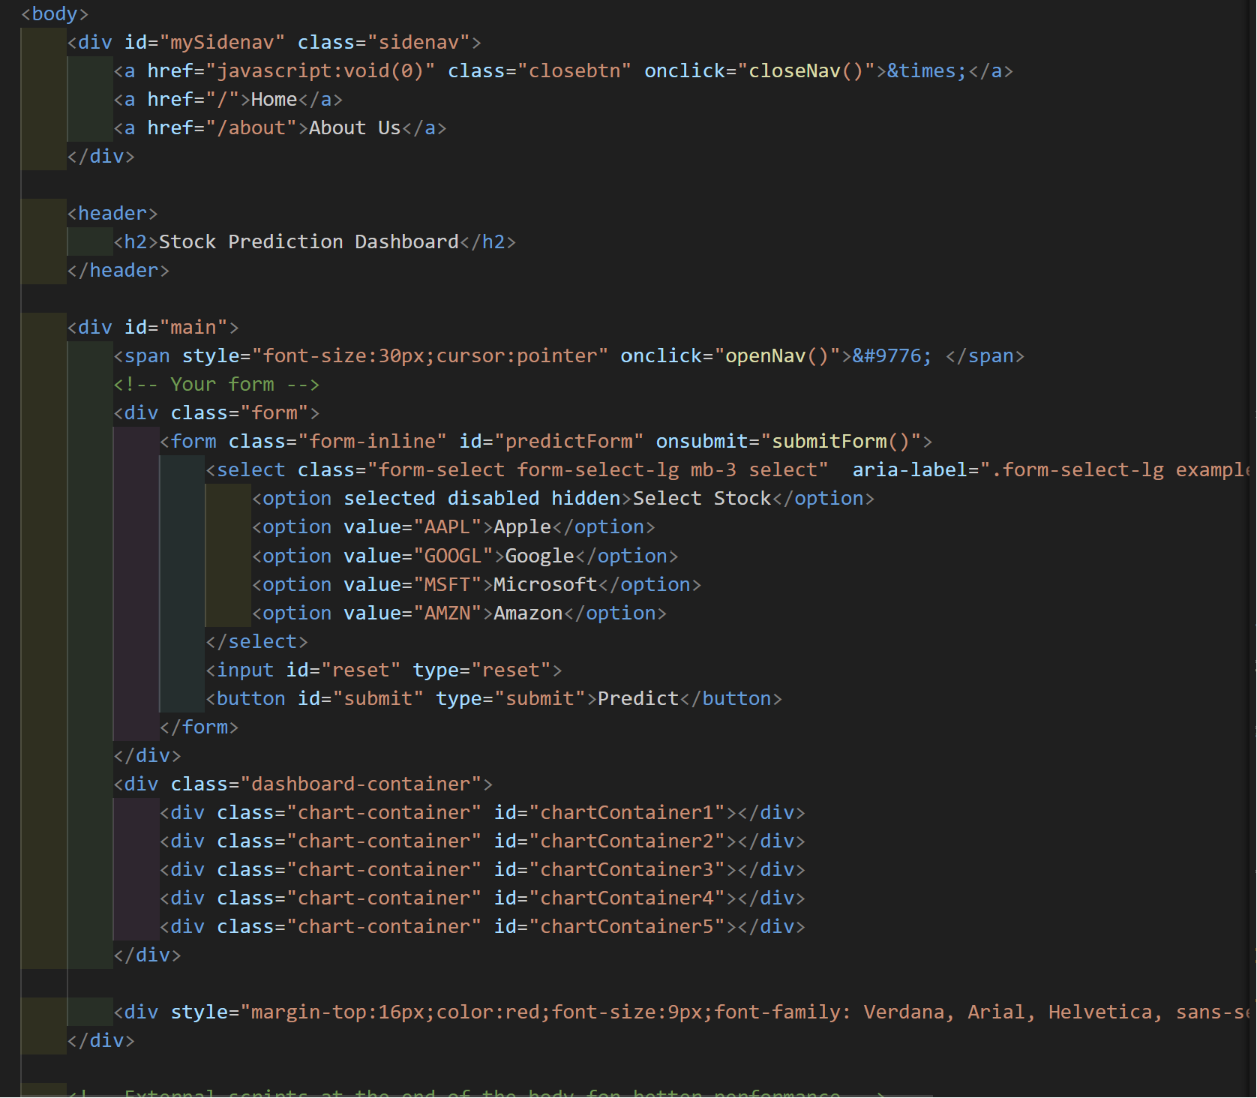
Html code to create form and dropdowns

Slide 26
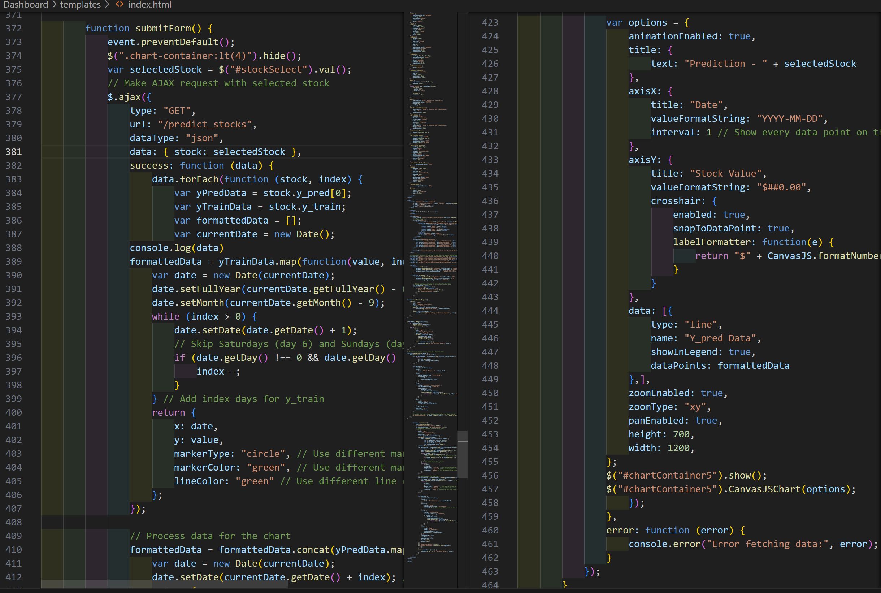

Slide 27
Expected Outcome
Accurate stock market predictions and insights for users
Improved investment decision-making for both novice and experienced users
Data visualization through interactive charts and graphs

Slide 28
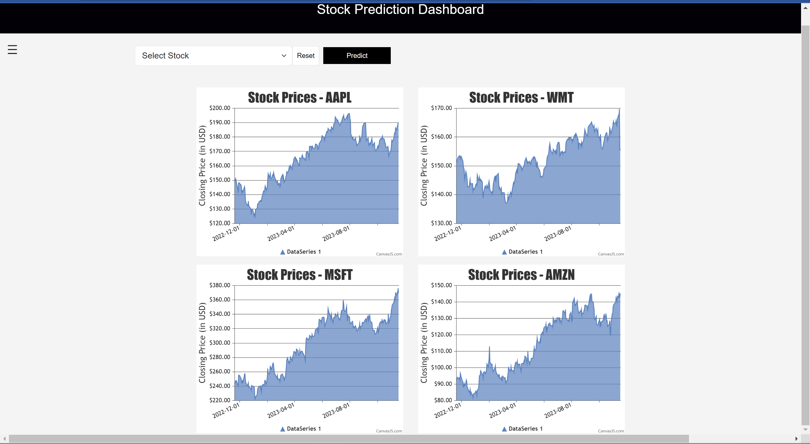
Dashboard

Slide 29
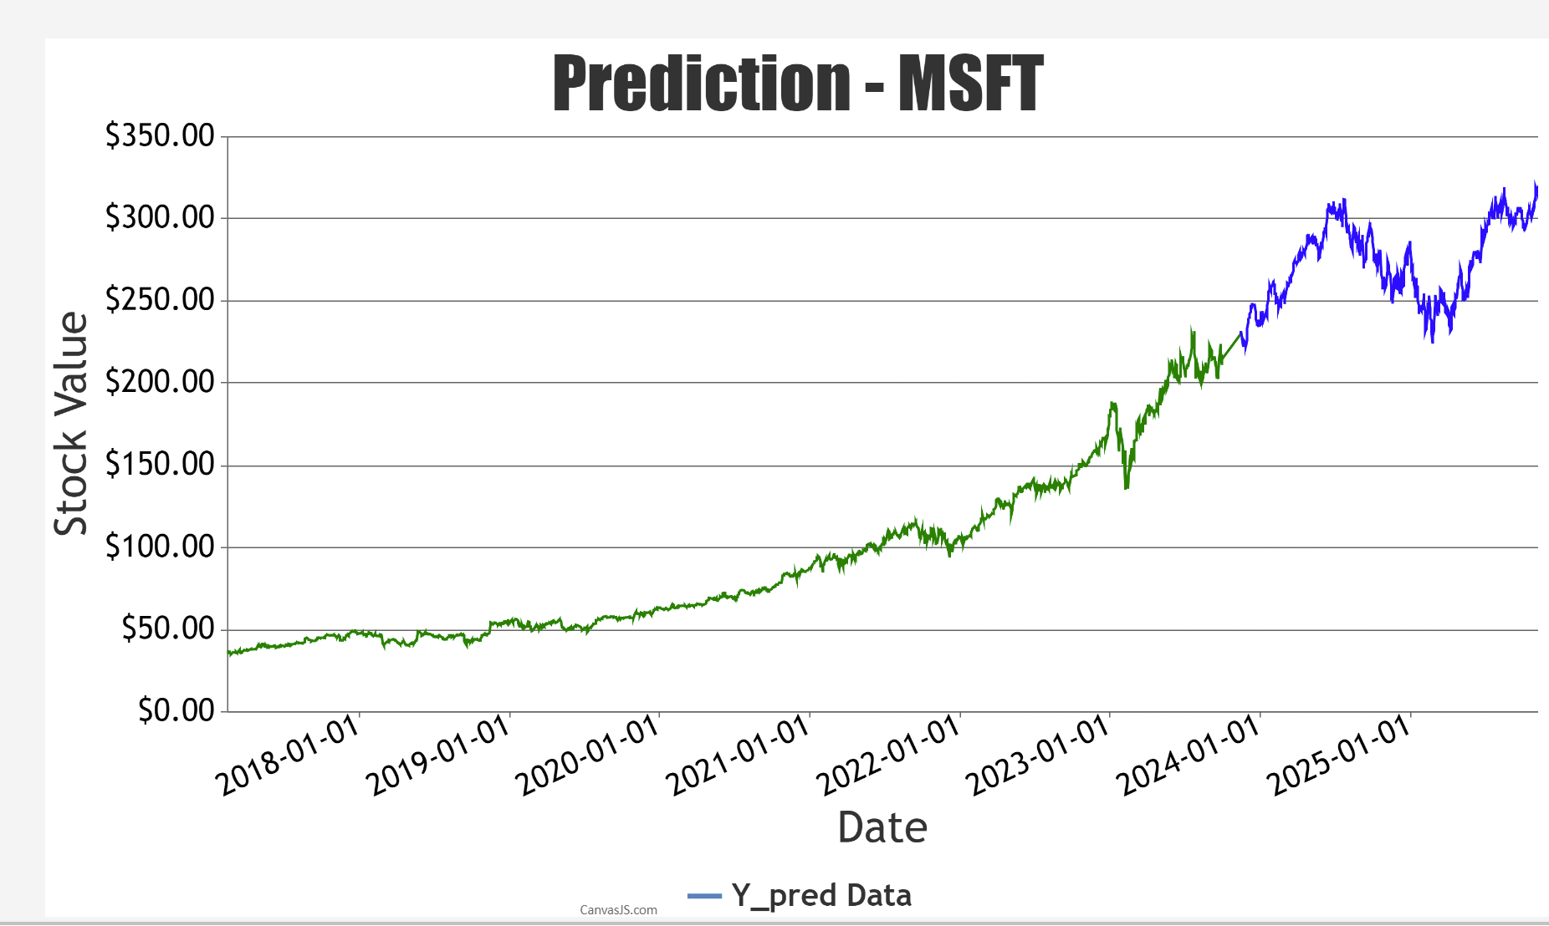
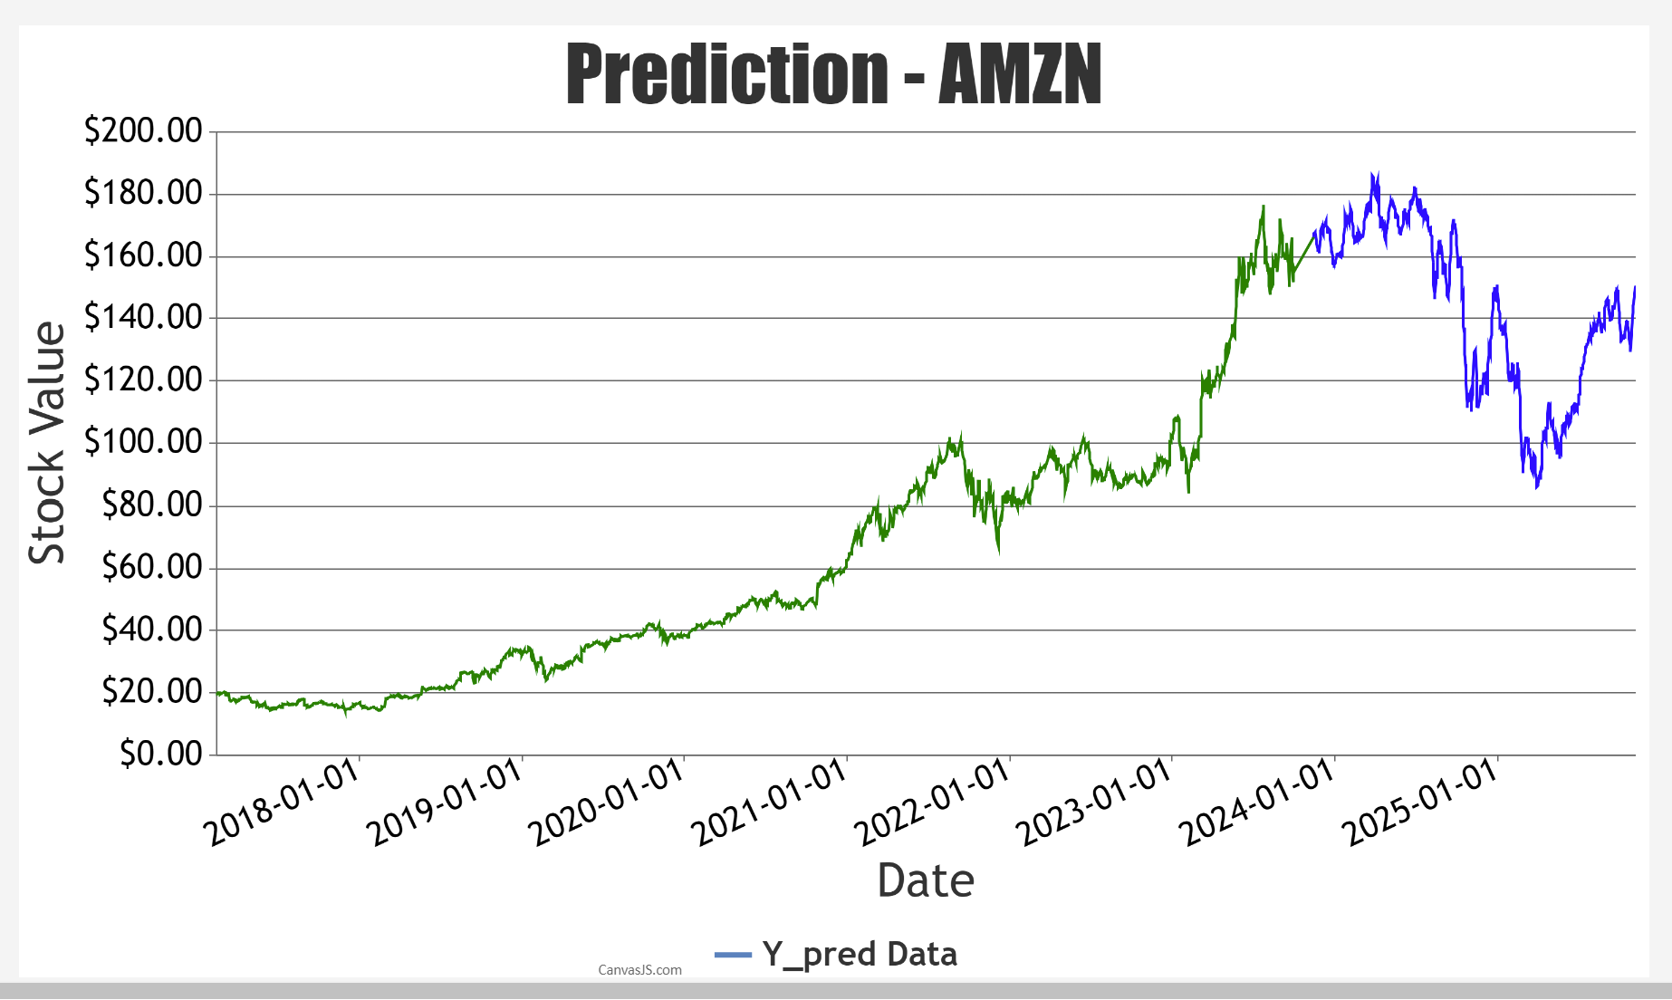
Prediction for Microsoft and Amazon This graph visually represents stock price predictions over time, with the y-axis depicting stock values and x-axis displaying corresponding dates.

Slide 30
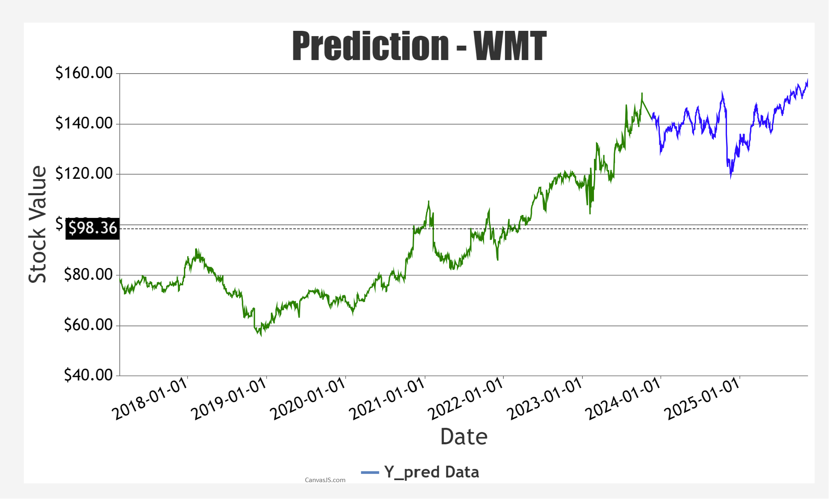
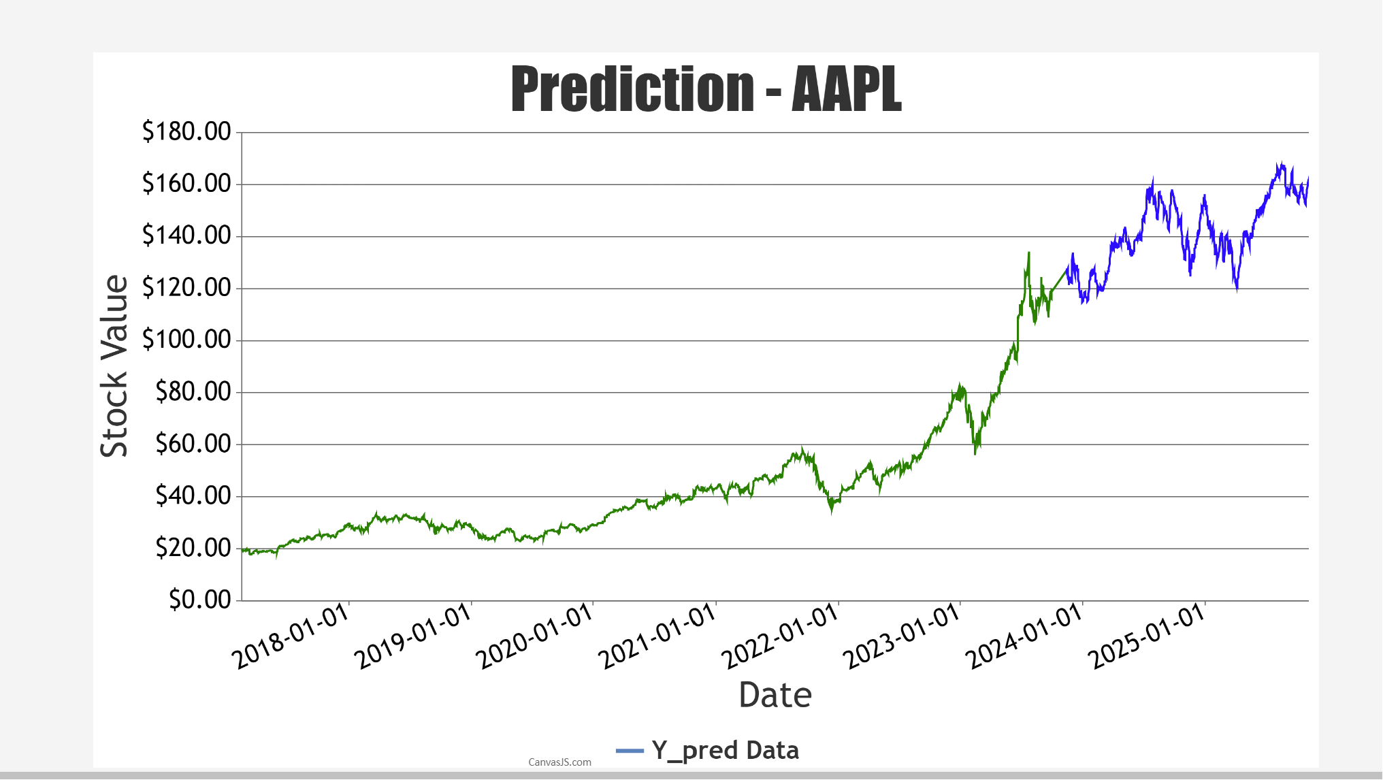
Prediction for Walmart and Apple This graph visually represents stock price predictions over time, with the y-axis depicting stock values and x-axis displaying corresponding dates.

Slide 31
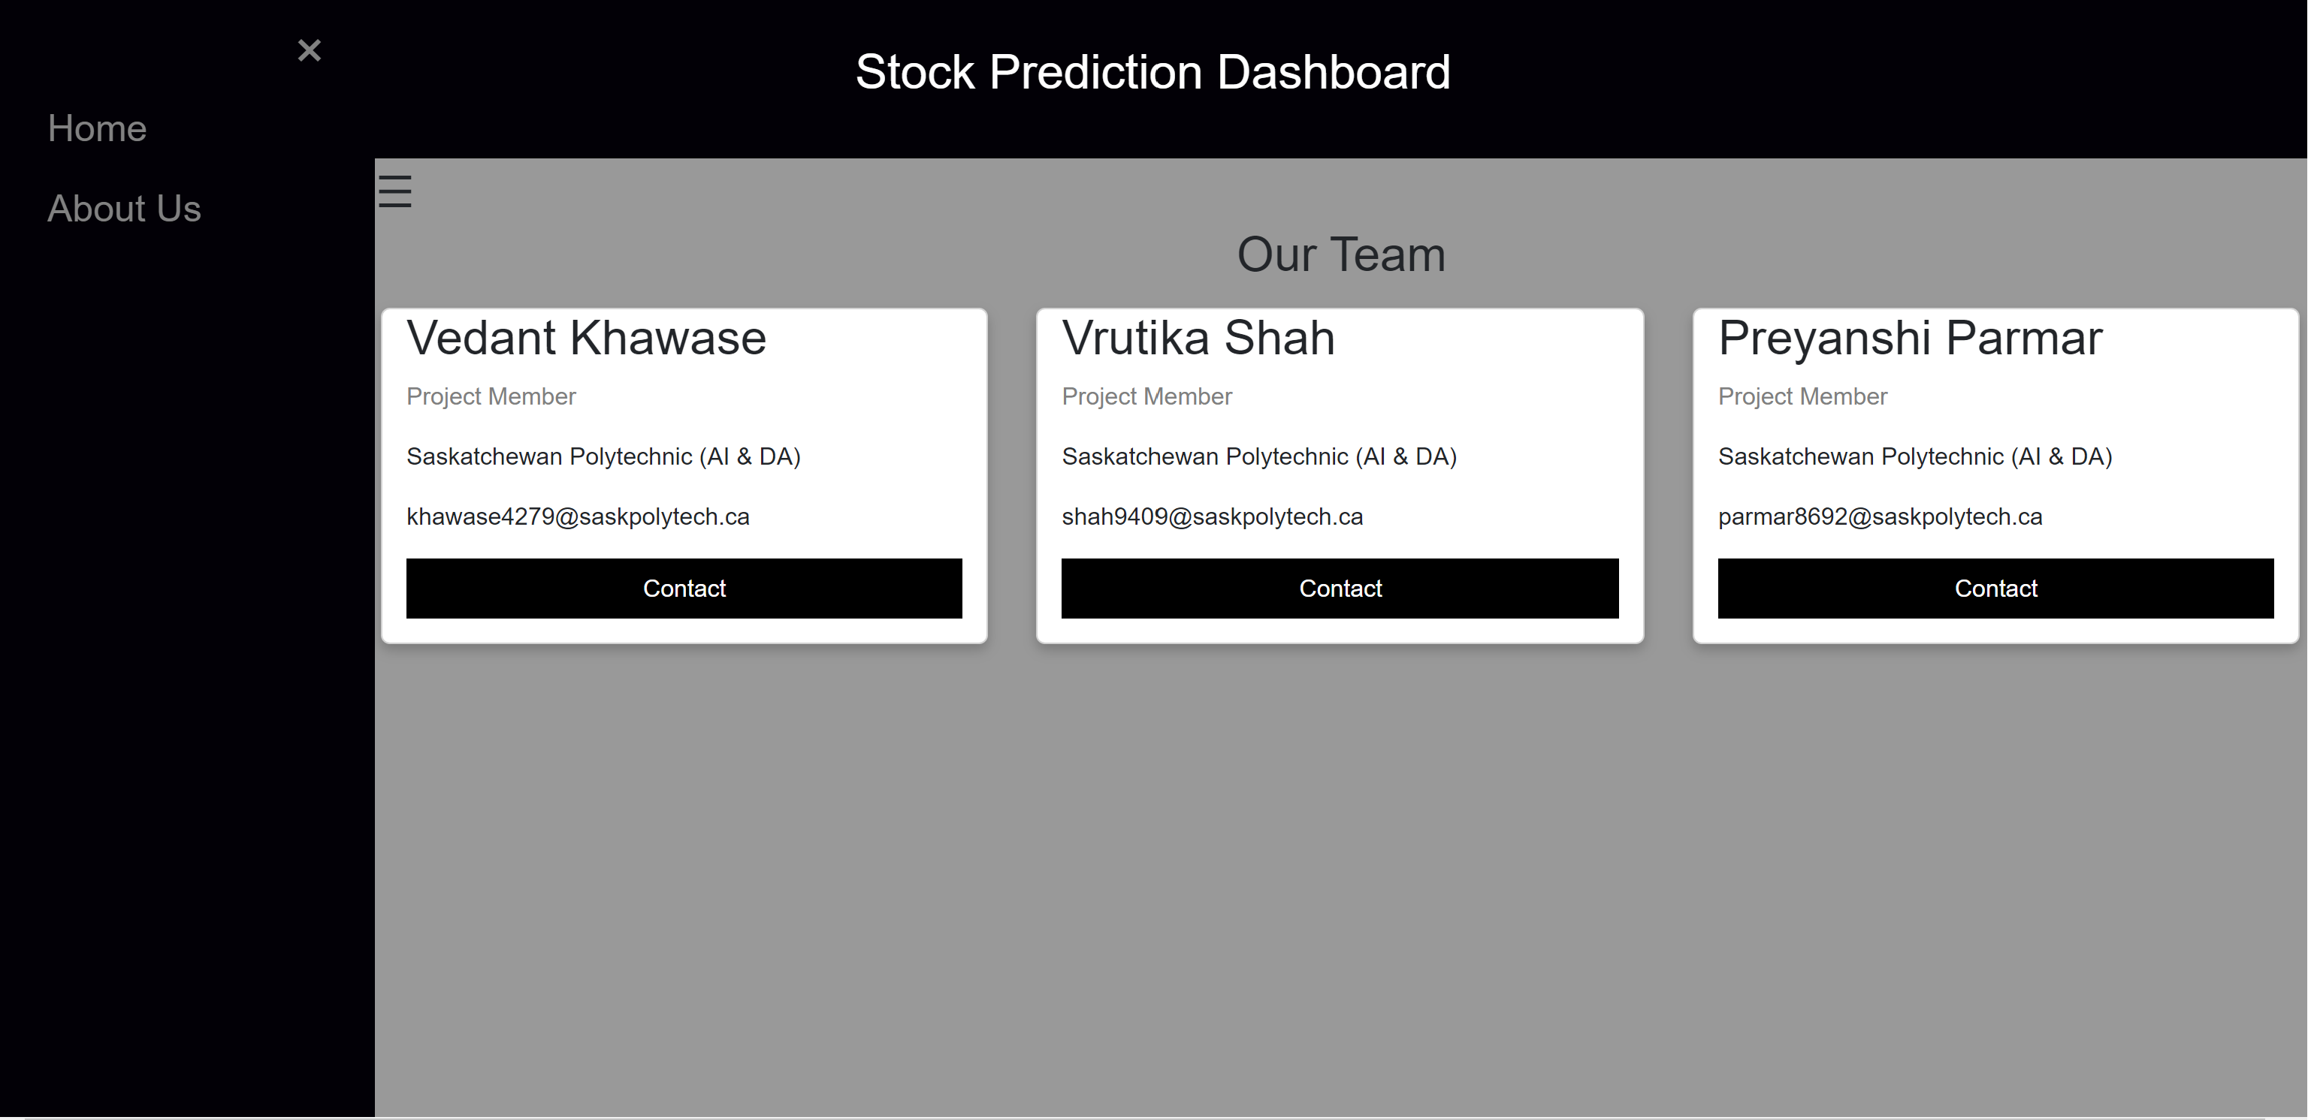
About us page

Slide 32
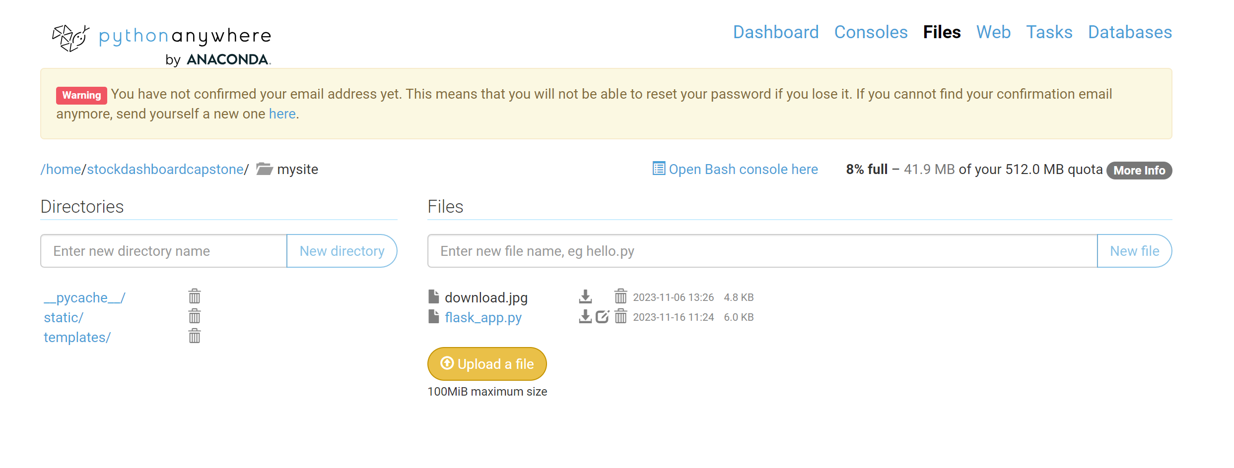
Deployment
Application hosted on Used free hosting website domain pythonanywhere.com
Url: https://stockdashboardcapstone.pythonanywhere.com/

Slide 33
LIMITATIONS AND FUTURE WORK
It only works for Historical data, and doesn’t consider other factors like Sentiment analysis, Financial Statements and son on.
In the future dynamically more stocks will be included to explore all the market stocks.

Slide 34
References
https://core.ac.uk/download/pdf/286268975.pdf
https://www.mdpi.com/2227-7072/11/3/94
https://towardsdatascience.com/time-series-forecasting-with-deep-learning-and-attention-mechanism-2d001fc871fc
https://www.researchgate.net/publication/354061072_Comparative_Analysis_of_Recurrent_Neural_Networks_in_Stock_Price_Prediction_for_Different_Frequency_Domains
https://www.ncbi.nlm.nih.gov/pmc/articles/PMC7517440/
https://arxiv.org/ftp/arxiv/papers/2111/2111.01137.pdf
https://link.springer.com/article/10.1007/s11280-021-01003-0#Sec15
https://www.w3schools.com/js/DEFAULT.asp
https:// pythonanywhere.com
https://i.stack.imgur.com/QEPAU.png
https://www.researchgate.net/profile/Mohamed-Abdelrahman-28/publication/337830532/figure/fig3/AS:834058519064577@1575866455615/A-simple-RNN-architecture.jpg

Slide 35
Thank you

